Slide 1
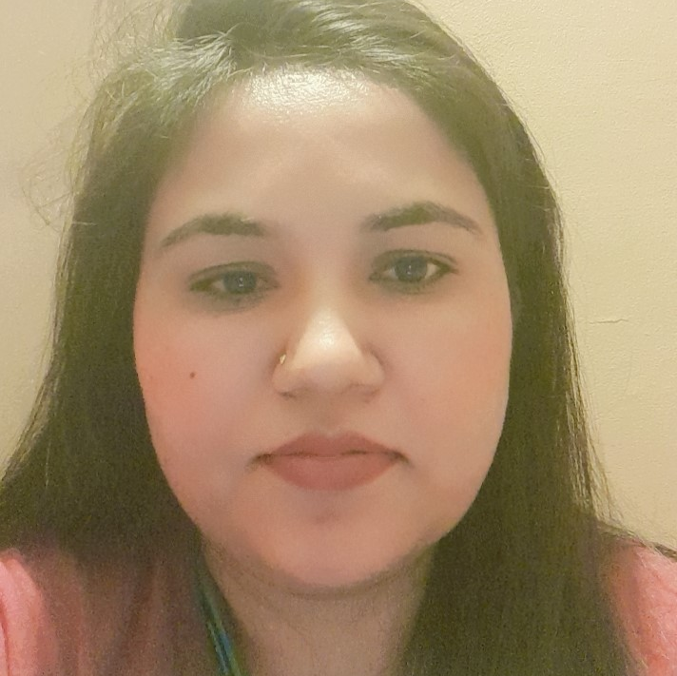
Insert Profile photo
Vaishali Barve– Senior Consultant
Banking and Financial Services Domain
B.E Computer Science
7 years experience in TCS
ISTQB Certified
AGILE Software Development Certified – Coursera
AWS Technical Essential Certifies - Coursera
Professional Achievements and Awards
Received appreciation for entire Team, from Global Head Core Tech Practice to successfully deliver DB migration project.
Received client appreciation also for the same.
Received client appreciation for publishing a paper on Image Processing Application((processing of cheques, cash letters etc.) full flow for MUFG to team members.)
Personal Statement:
A highly skilled professional with over 10.8 years of experience in IT. My expertise lies in PL/SQL, Unix, production support, QA Testing, and personnel management. I excel in communication, creativity, and strategic thinking. I hold a B.E. degree and have contributed to leading organizations like TCS and Capgemini.
Expertise and Competencies:
Specific focused on roles as PLSQL Developer, Production Support and QA Manual Tester.
Around 5 years of experience as team lead for a Production Support and DB Migration Project.
Type of Industry: | IT Industry
Clients | Nationale Netherlands, Morgan Stanley, MUFG, Credit Suisse
Role/Title: | Offshore Team Lead, QA Tester
Responsibilities: | Nationale Netherlands - Led offshore team operations (10+ members), enhancing efficiency through workflow streamlining and best practice implementation. Received client appreciation for creating and presenting a comprehensive security document, contributing significantly to the success of a database migration project—ensured accurate data migration, system stability, and collaborated cross-functionally for issue resolution. Morgan Stanley - Led testing for EV Portal, evaluating trader/salesperson impact, creating detailed documentation, and executing tests to ensure FX trading platform compliance. Efficiently tracked defects, fostering clear communication with the development team for project success. MUFG - Led 24x7 production support for 300+ applications, ensuring minimal downtime, managing critical incidents, and implementing proactive solutions for system stability.
Tools | Putty, SQL Developer, ServiceNow, HPSM, HPQC, WinSCP, Beyond Compare, JIRA
Operating Systems: | Windows, Unix
Software / Languages: | Unix, PLSQL, C++

